Slide 1
FOR LOOPS
Team 13:
Tianming Chen
Christine Luong
Kathryn Ziccarelli
FEBRUARY 11, 2022

Slide 2
TABLE OF CONTENTS
01
WHAT ARE LOOPS?
02
FOR LOOP SYNTAX
03
NESTED LOOP SYNTAX
04
FOR LOOPS & NESTED FOR LOOPS EXAMPLES
05
EXERCISE 6-11
06
POLLING QUESTIONS
1

Slide 3
WHAT ARE LOOPS?
ITERATOR
ASSIGNOR
EXECUTION
A way to repeat tasks a defined number of times under certain conditions
Taking an integer value and assigning it successive values from a vector
Statement or condition is executed
2

Slide 4
TYPES OF LOOPS
FOR LOOP
NESTED FOR LOOP
Used for iterating over a sequence (e.g. list, tuple, dictionary, string)
Allows looping through elements in multiple vectors (or multiple dimensions of a matrix) and performs some operation
3

Slide 5
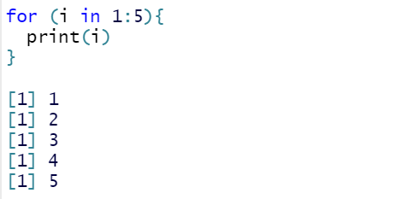
FOR LOOP SYNTAX
for (variable in sequence) {
execute statement
}
EXAMPLE:
4

Slide 6
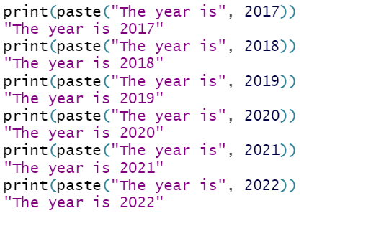
HOW CAN THIS BE IMPROVED?
Suppose you want to do several printouts of the following:
The year is [year] where [year] is equal to 2017 through 2022
5

Slide 7
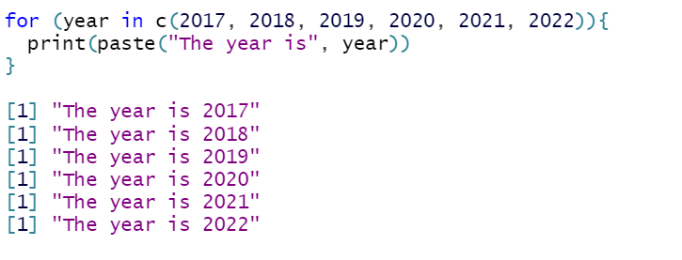
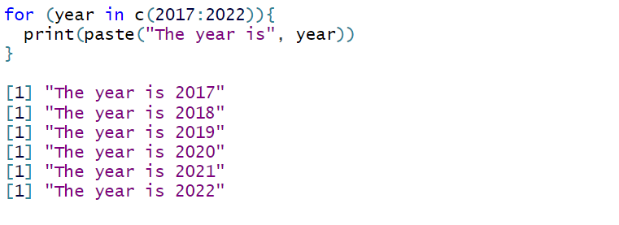
WRITING A SIMPLE FOR LOOP
Better
Best
6

Slide 8
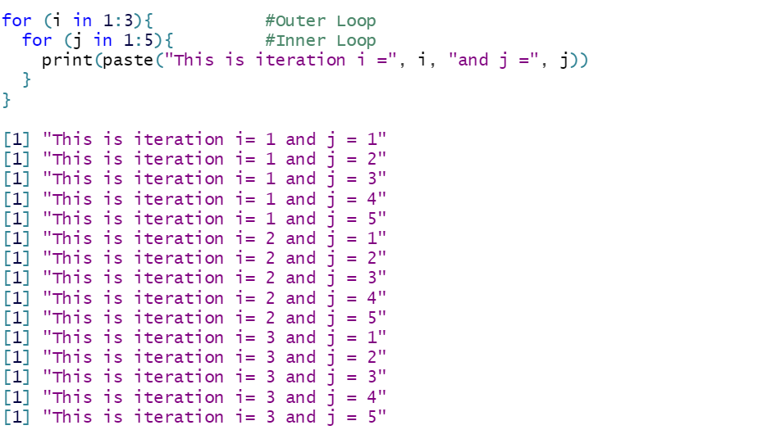
NESTED FOR LOOP SYNTAX
for (variable in sequence) {
for (variable in sequence) {
execute statement
}
}
#Outer Loop
#Inner Loop
7

Slide 9
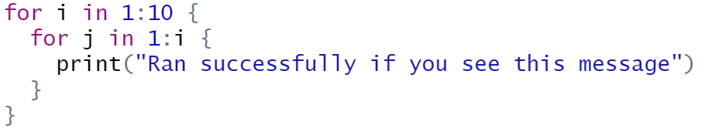
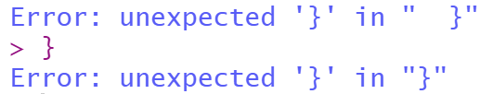
EXERCISE 1 – Quick Debug Challenge
9
Notes:
Ok so, let’s do some quick review exercises on what we just talked about.
The first question here is in a very basic nested

Slide 10
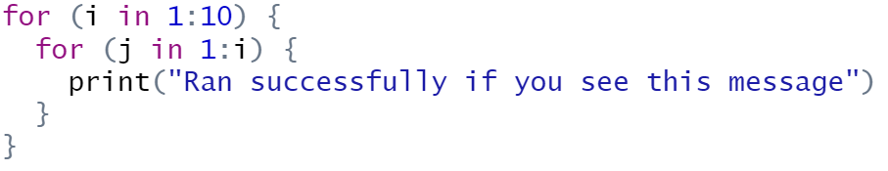
EXERCISE 1 – Quick Debug Challenge
10

Slide 11
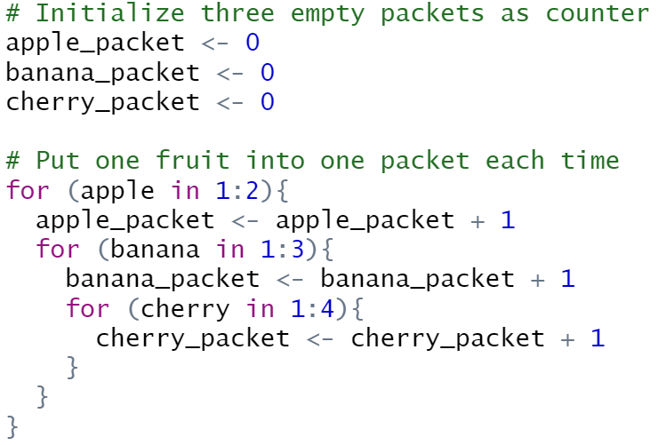
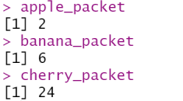
EXERCISE 2 – Nested For Loop
How many fruits are there in each packet at the end?
10

Slide 12
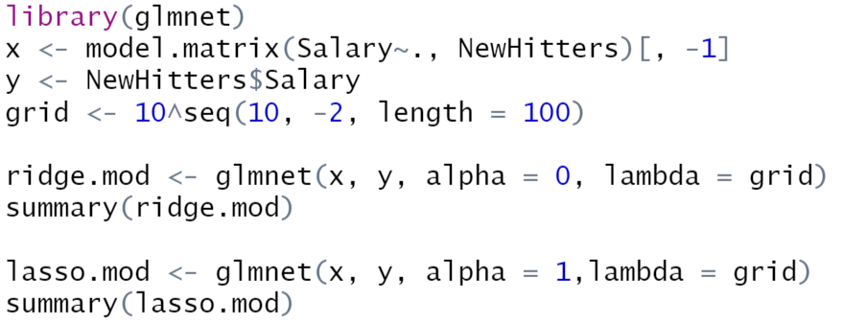
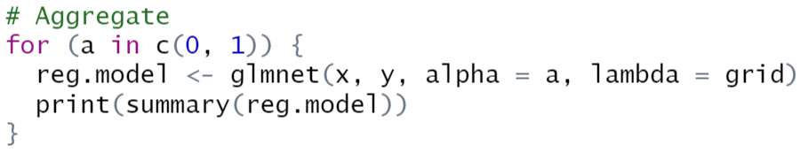
EXERCISE 3
Can we aggregate the Ridge and the Lasso into one line?
11

Slide 13
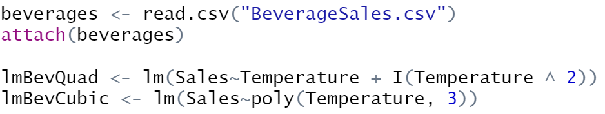
GRID SEARCH EXAMPLE
12

Slide 14
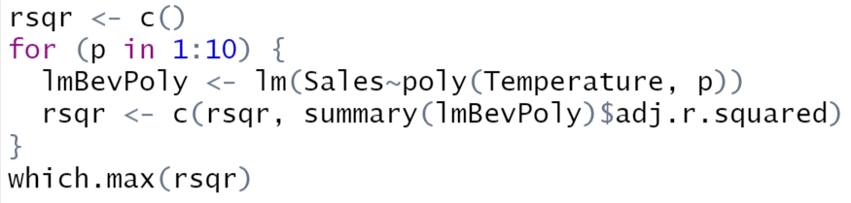

GRID SEARCH EXAMPLE
13

Slide 15
GRID SEARCH EXAMPLE
14

Slide 16
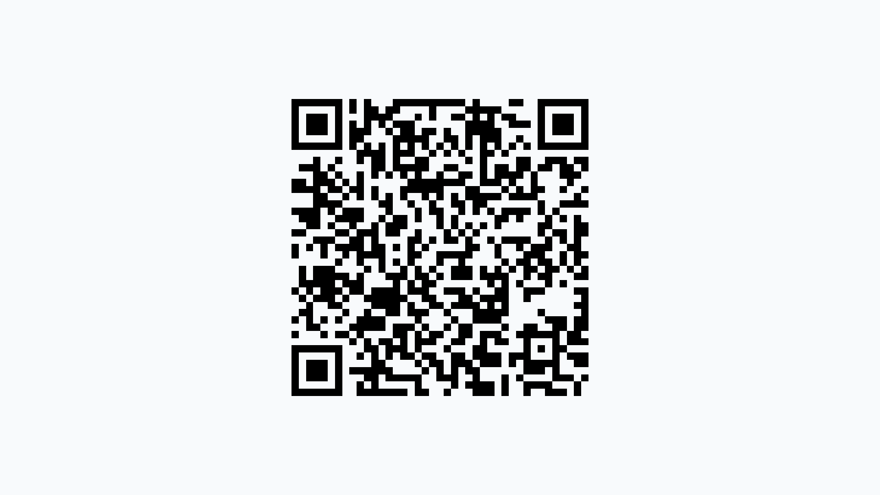
POLL TIME!
www.pollev.com/christineluong286
15

